Slide 1
Summer Internship, June-July,2026– CODMAV
Review-3
Project Title : SYNTHETIC DATASET CREATION FOR COEXISTING DISEASES IN RICE LEAF
Project ID : 09
Project Guide : Prof Swetha Patil
Project Team Members : Nidhi CR, PES2UG23CS382
Jayashree D, PES2UG24CS203
Deliverable Submitted: IEEE Paper Draft/Proof of Concept

Slide 2
Outline
Abstract
Suggestions from review-2
Objectives
Design(Architecture/Flowchart/use case diagram/or Class Diagram)
Methodology Adopted- Algorithms/Techniques Adopted
Implementation- Code snippets
Results – output screenshots
Conclusion and Future Enhancement
References

Slide 3
Abstract
This work focuses on developing a synthetic multi-disease rice leaf dataset to address the lack of publicly available datasets containing multiple diseases on a single rice leaf.
The proposed pipeline involves dataset collection, preprocessing, lesion segmentation, disease patch extraction, copy-paste augmentation, and multi-band Laplacian pyramid blending to generate realistic multi-disease images. The generated dataset is validated using image quality metrics such as PSNR and SSIM and further evaluated using multi-label classification models to assess its effectiveness for disease recognition.

Slide 4
Problem Statement and Research Gaps Identified
Existing rice leaf disease datasets primarily contain images of individual leaves affected by a single disease. While these datasets are widely used for disease analysis and model development, they do not adequately represent real-world field conditions where multiple diseases can occur simultaneously on the same leaf. The absence of publicly available multi-disease rice leaf datasets creates a significant gap in agricultural image resources and limits research on disease co-occurrence and multi-disease analysis. Therefore, there is a need for a dedicated dataset containing rice leaf images exhibiting multiple diseases on a single leaf.

Slide 5
1.Lack of Multi-Disease Rice Leaf Datasets Existing rice disease datasets mainly contain single-leaf, single-disease images.
2.Poor Representation of Real Field Conditions Current datasets do not adequately capture disease co-occurrence observed in agricultural fields.
3.Limited Rice-Specific Multi-Label Resources Most multi-label disease studies focus on crops such as tomato and apple rather than rice.
4.Emphasis on Classification Over Dataset Development Existing research primarily develops disease detection models instead of creating new datasets.
5.Limited Use of Image Synthesis for Dataset Expansion Advanced image synthesis techniques are rarely used to generate multi-disease rice leaf samples.

Slide 6
Literature Survey
Sl.No | Paper | Technique / Method | Limitation | Relevance to Project
1 | Paddy Doctor (2022) | Rice disease dataset creation & benchmarking | Single-disease images only | Source dataset for BLB, Blast and Brown Spot
2 | Advanced Multi-Label Tomato Leaf Disease Identification (2025) | ViT + EfficientNet + Multi-label Classification | Tomato domain | Supports multi-label disease learning
3 | Mixed Disease Recognition in Apple Leaves (2026) | Multi-task Learning | Different crop species | Closest reference to multi-disease recognition
4 | Otsu Multi-Threshold Image Segmentation (2023) | Otsu Thresholding | Sensitive to illumination variation | Lesion segmentation baseline

Slide 7
Sl.No | Paper | Technique / Method | Limitation | Relevance to Project
5 | Recognition System for Leaf Images (2017) | Contour Detection | Traditional method | Disease patch boundary extraction
6 | Simple Copy-Paste Augmentation (2021) | Copy-Paste Augmentation | Not agriculture-specific | Key technique for dataset creation
7 | Copy-Paste with Poisson Blending (2023) | Copy-Paste + Poisson Blending | Medical domain | Direct inspiration for lesion insertion
8 | Image Quality Assessment Study (2019) | SSIM, PSNR, MSE, FSIM | Not plant-specific | Dataset quality validation

Slide 8
Suggestions from Review -2
Continue with blending and prepare a proper augmented dataset with
desired Combination classes
Start with Model training explore 3-4 methods and validate

Slide 9
Objectives
To create a realistic synthetic rice leaf dataset containing multiple coexisting diseases.
To extract disease lesions and build a reusable disease patch library from single-disease images.
To generate high-quality multi-disease images using copy-paste augmentation and blending techniques.
To validate the generated dataset using image quality metrics and multi-label classification models.
To provide a benchmark dataset for future research on multi-disease rice leaf analysis.

Slide 10
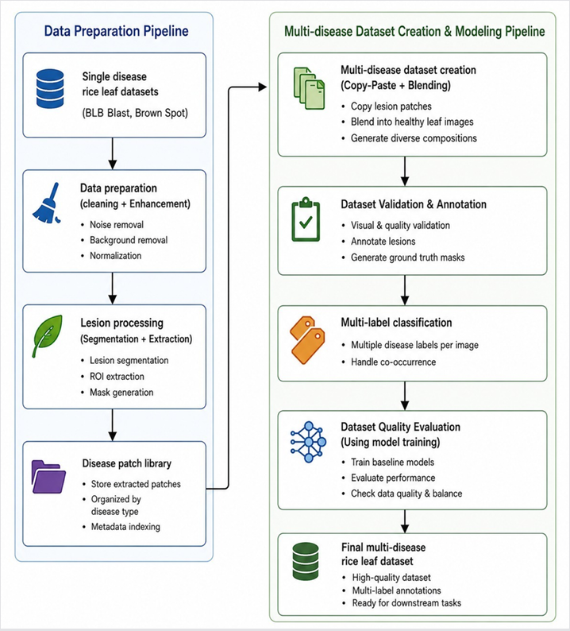
Design
1.Single-disease rice leaf datasets are collected and preprocesssed through cleaning and image enhancement techniques.
2.Disease lesions are segmented and extracted to create a
disease patch library for further processing .
3.Extracted disease patches are combined using copy-paste
Augmentation and blending techniques to generate
multi-disease rice leaf images.
4.The generated images are validated , annotated and
organized into a multi –label dataset .
5.Multi-label classification models are used to evaluate dataset quality and verify the effectiveness of the created dataset .

Slide 11
Methodology Adopted
SL.No | Stage | Methods Explored | Final Method Used
1 | Dataset Collection | Single dataset , Multiple public datasets | Multiple public datasets (Blast, BLB, Brown Spot)
2 | Duplicate Removal | MD5, pHash | MD5 + pHash
3 | Image Enhancement | CLAHE , Gaussian Blur | CLAHE + Gaussian Blur
4 | Background Removal | BiRefNet ,HSV ,SAM2 | SAM2 + HSV prompts
5 | Lesion Annotation and Lesion Segmentation | Manual , SAM-assisted | SAM2 segmentation
6 | Lesion Extraction | v1, v2,v3 | Binary thresholding, contour detection, RGBA patch creation

Slide 12
SL.No | Stage | Methods Explored | Final Method Used
7 | Leaf Masking | Otsu , GrabCut | Otsu + GrabCut
8 | Lesion Placement | Random , PCA | PCA-guided placement
9 | Copy-Paste | Simple , Feathered alpha | Feathered alpha
10 | Blending | Gaussian , Alpha , Poisson ,Multi-band | Multi-band Laplacian Pyramid
11 | Dataset Augmentation | Geometric/photometric | Geometric and photometric
12 | Dataset Validation | PSNR; SSIM ,NIQE , BRISQUE, FID | PSNR + SSIM, NIQE, BRISQUE, FID
13 | Model Evaluation | SVM ,EfficientNet, ViT | SVM, EfficientNet, ViT

Slide 13
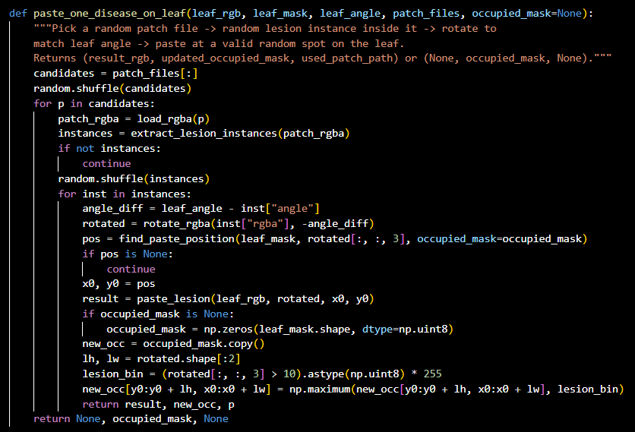
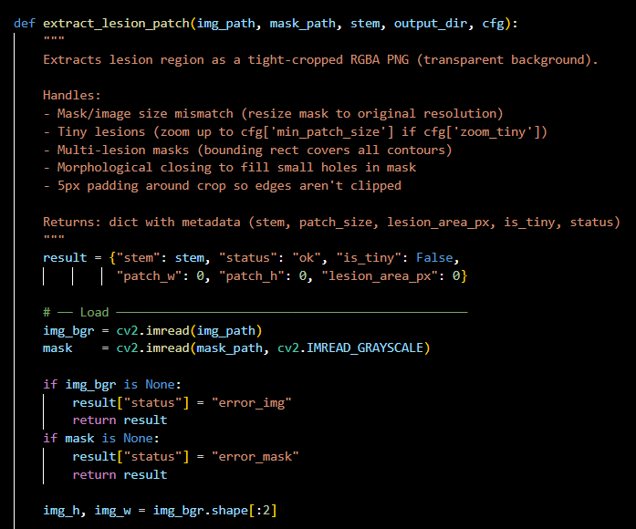
Implementation
Extraction and copy-paste

Slide 14
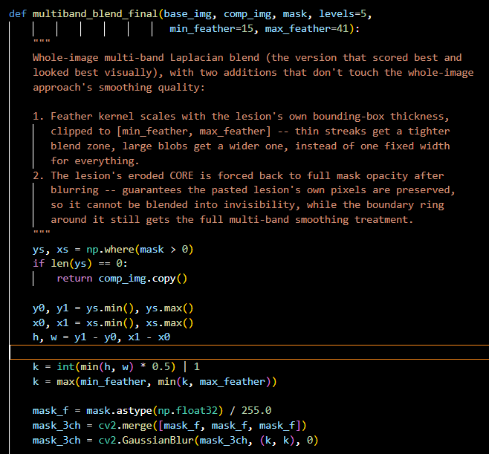
Blending

Slide 15
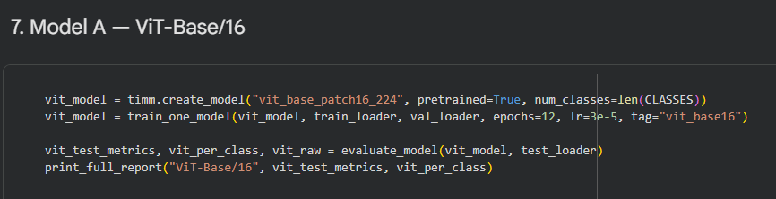
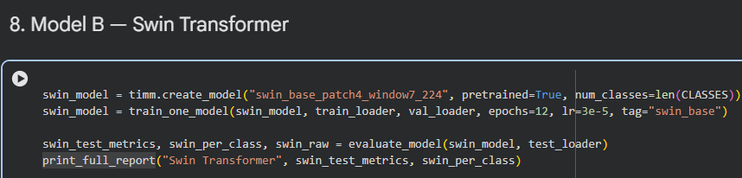
Model training

Slide 16
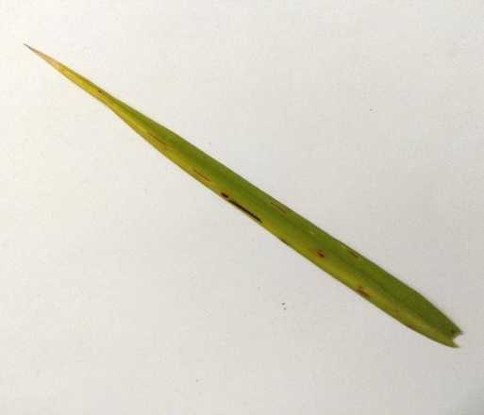
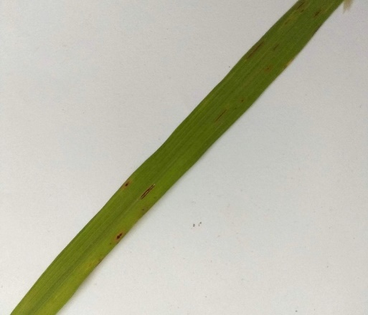
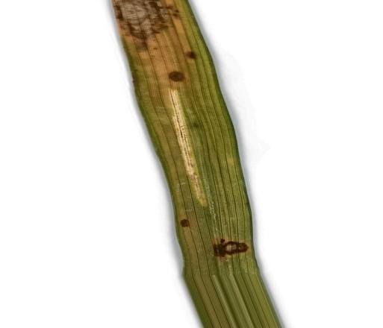
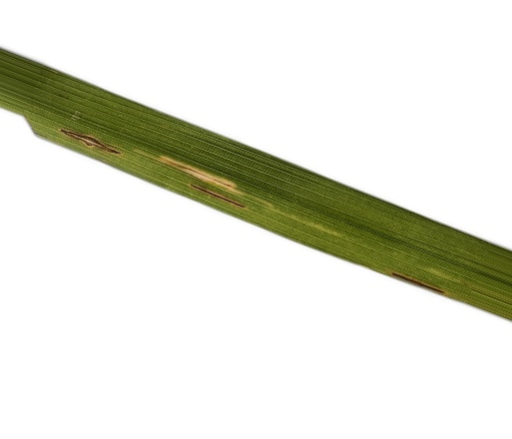
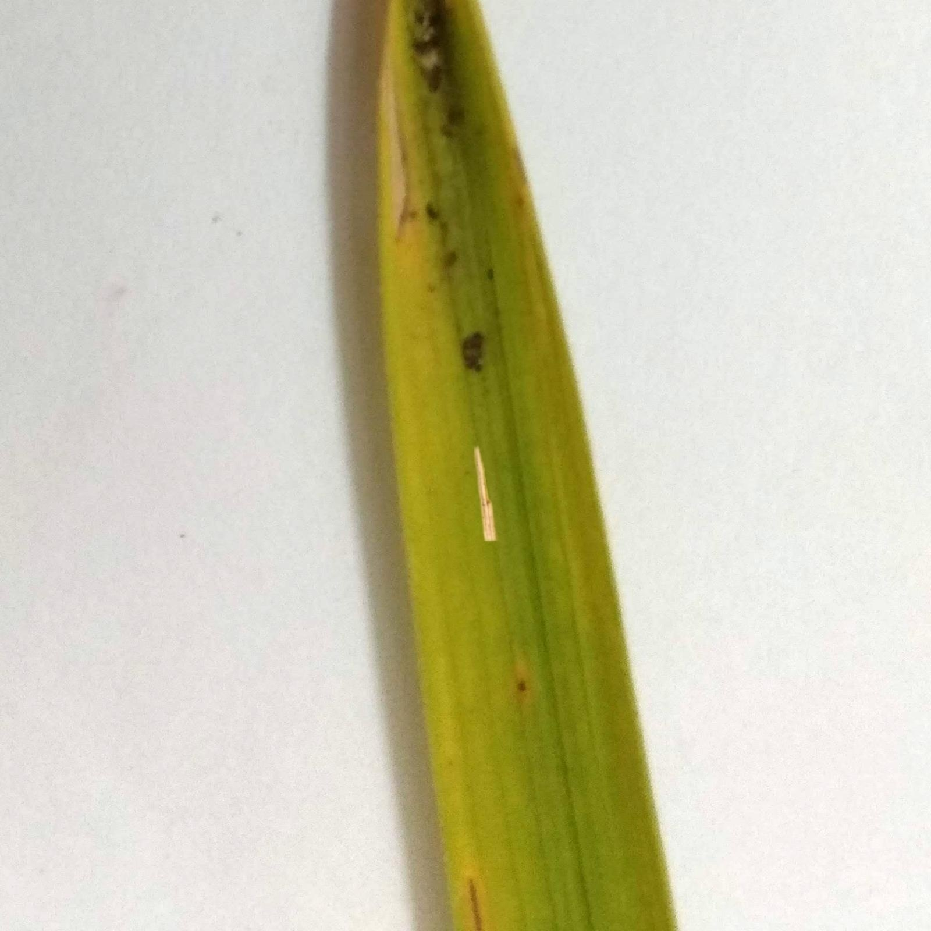
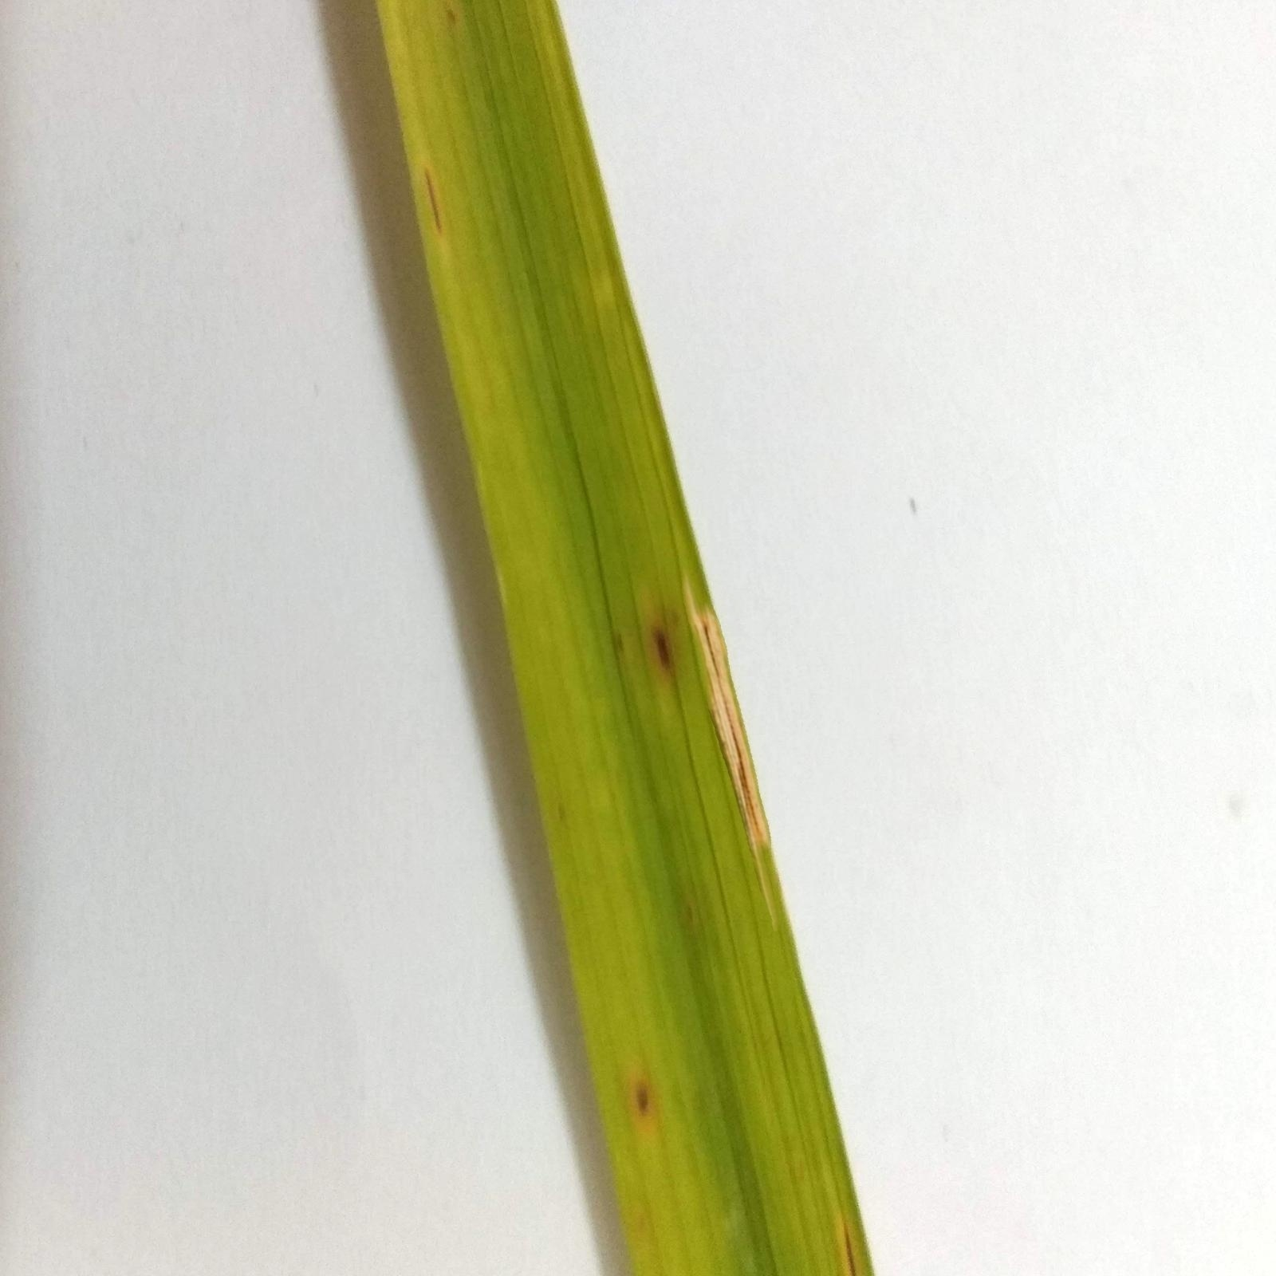
Results
Blast on Brownspot
BLB on Brownspot
BLB on Blast

Slide 17
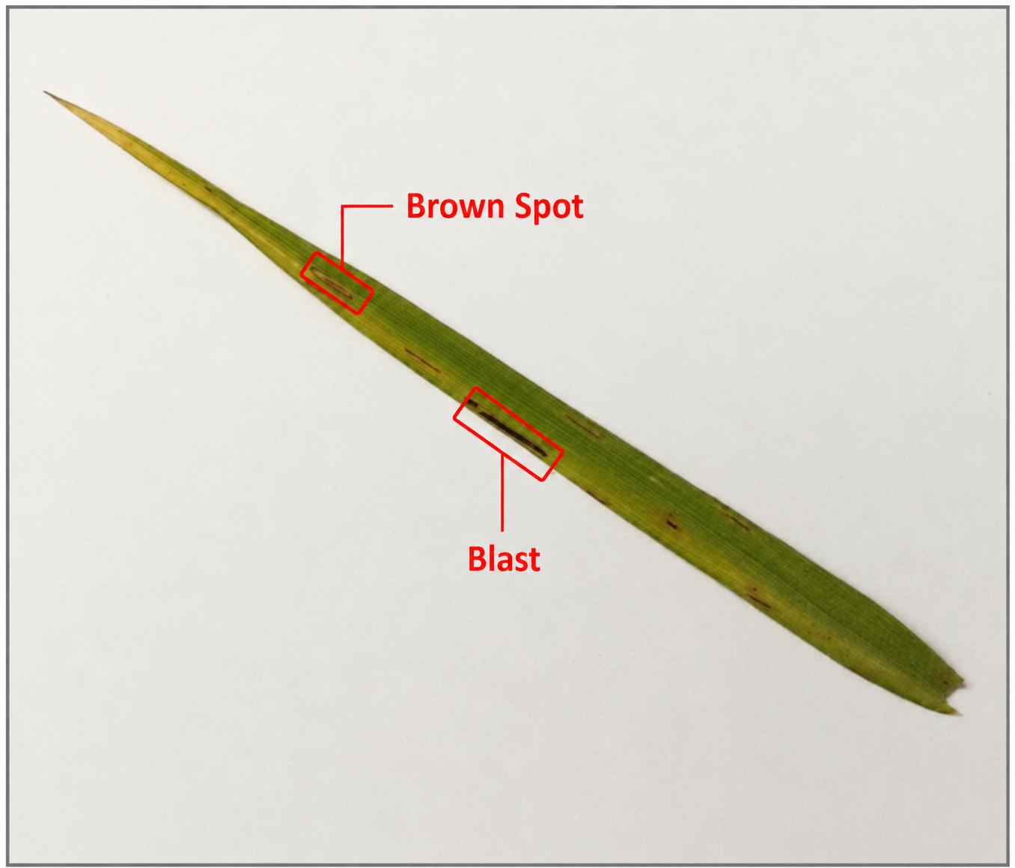
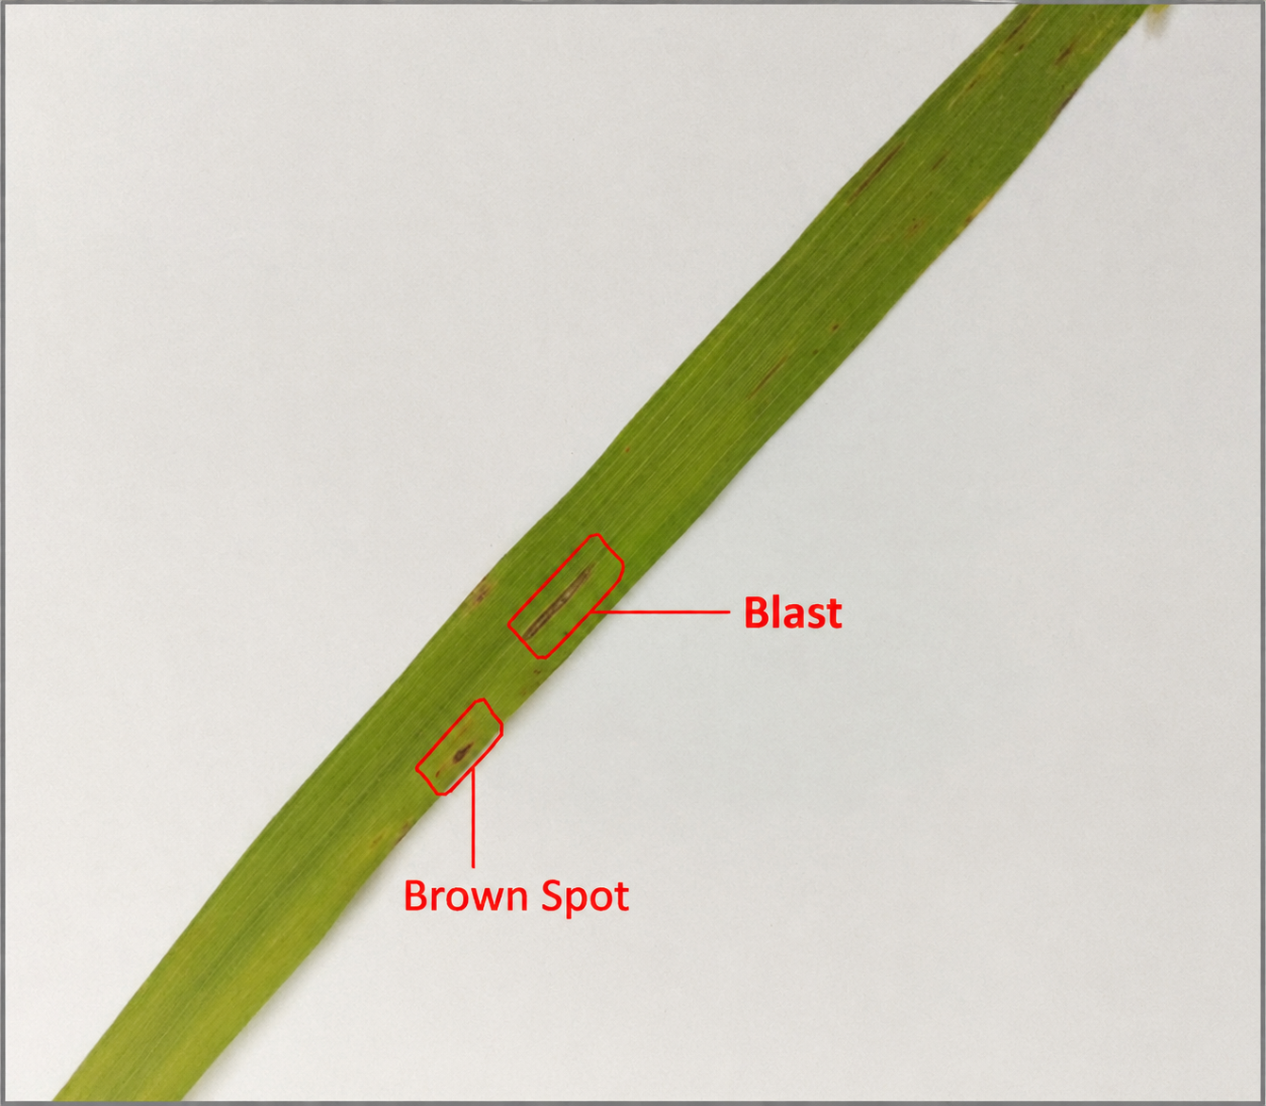
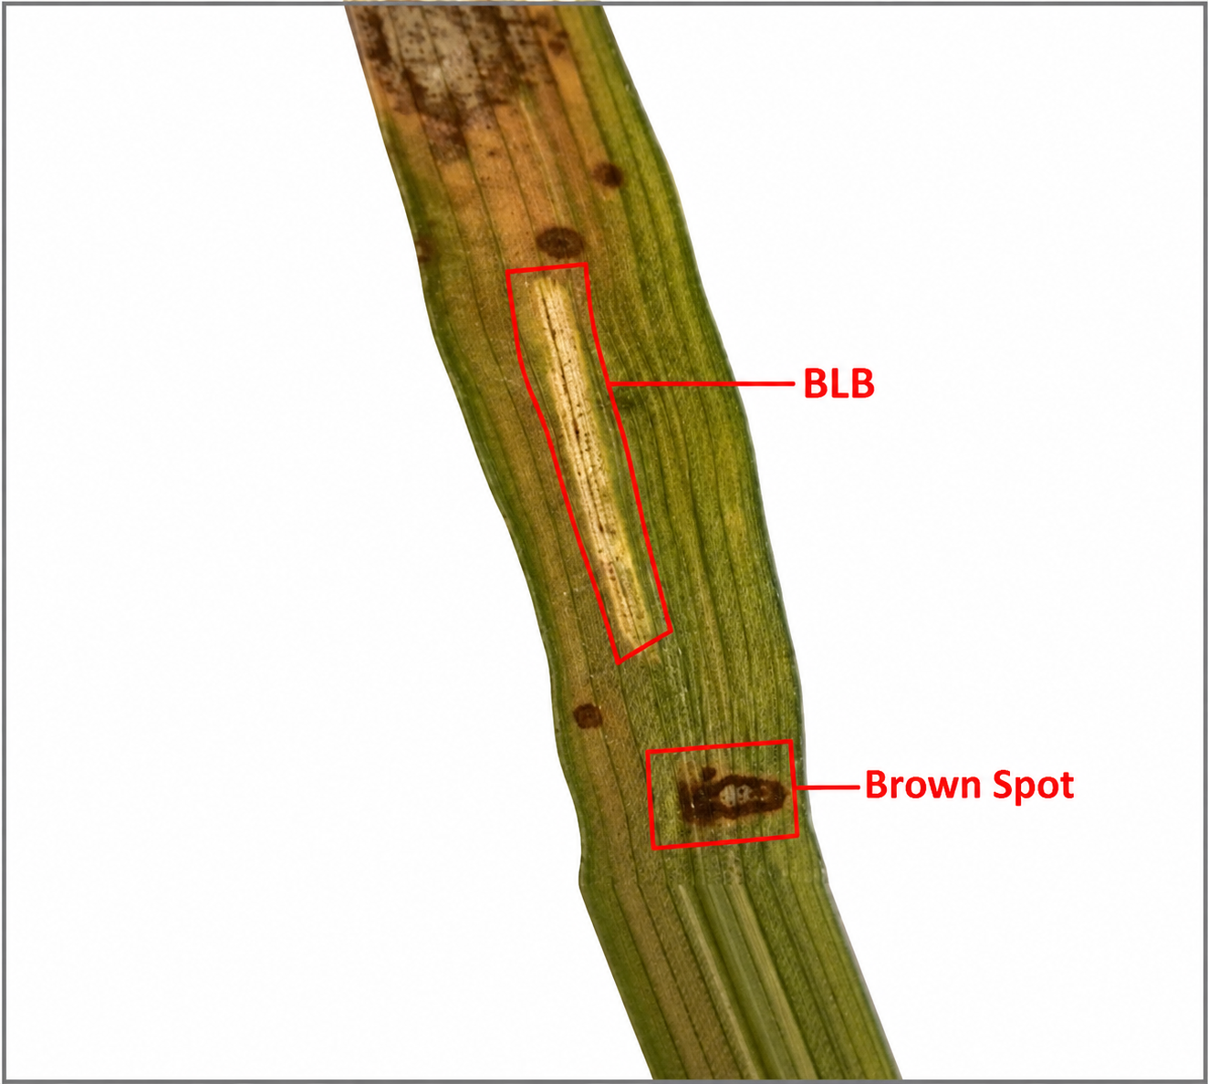
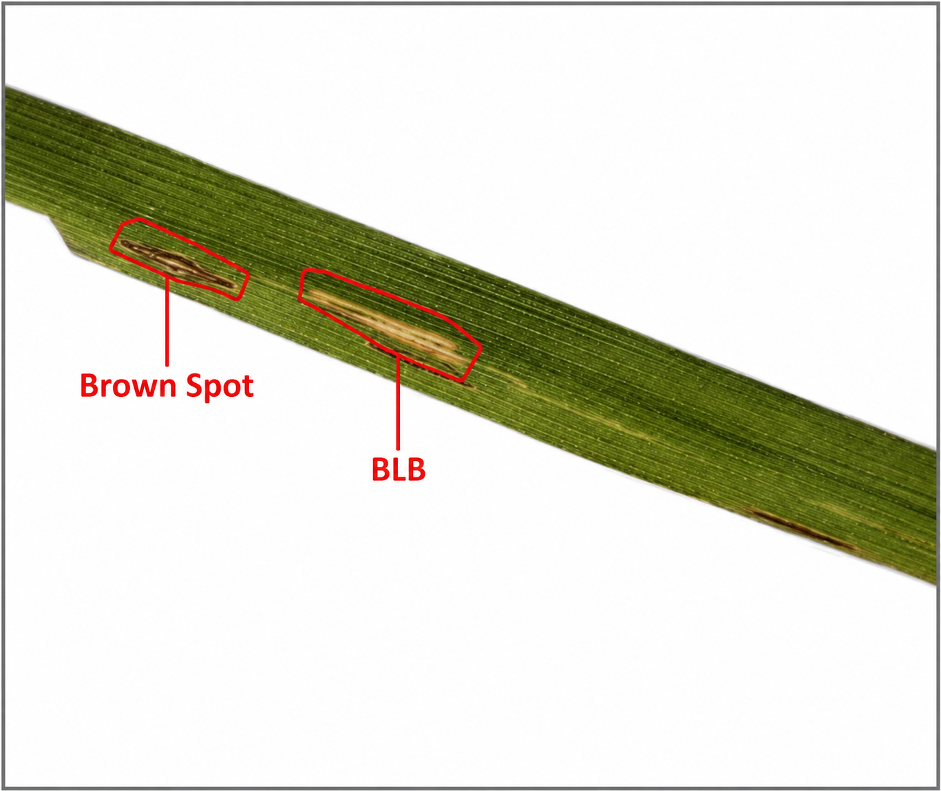
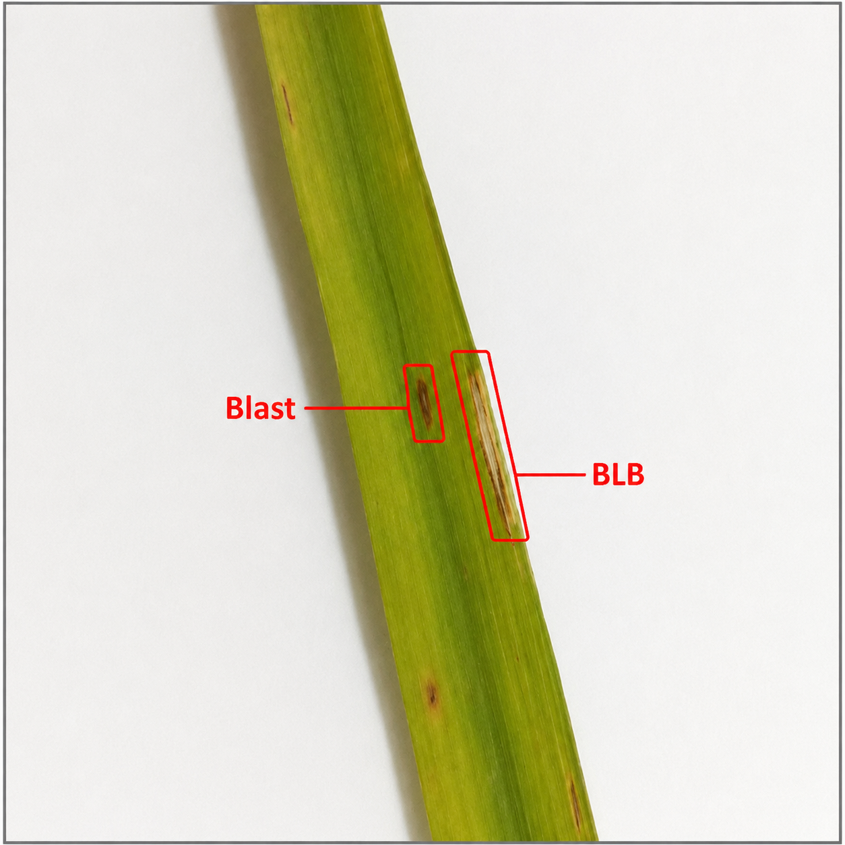
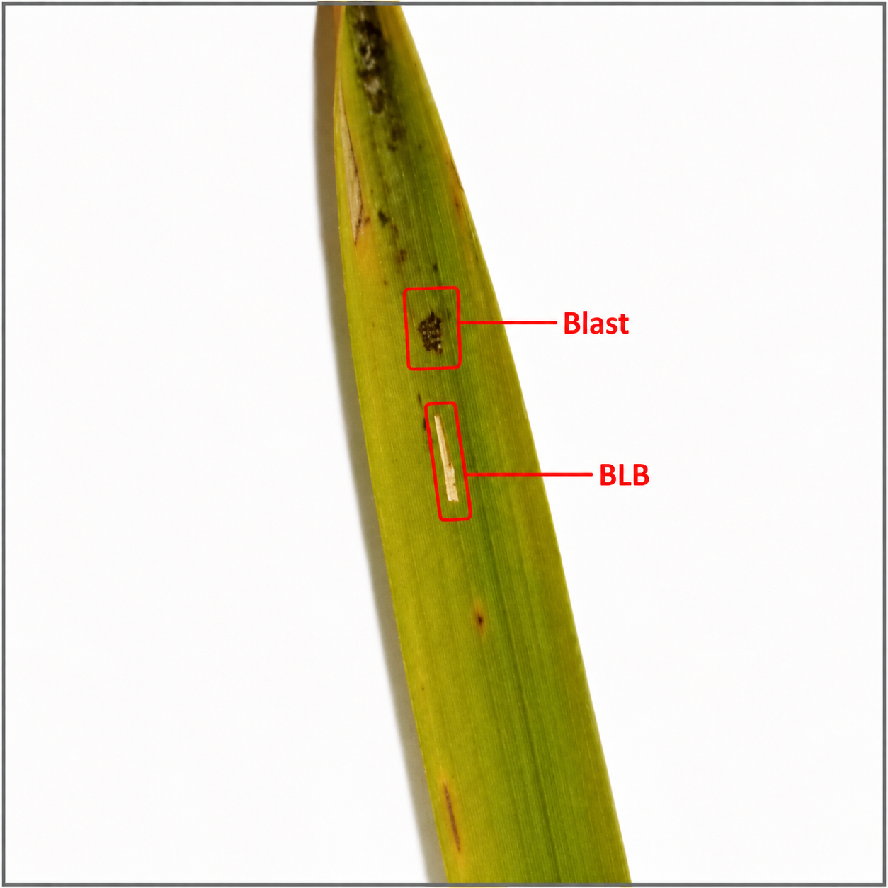
Multi-labels

Slide 18
Model Configuration
Models | Accuracy | Precision | Recall | F1 score
SVM | 0.5025 | 1.00 | 0.50 | 0.62
EfficientNet | 0.6670 | 0.72 | 0.48 | 0.52
ViT-Swin Transformer | 0.8841 | 0.9479 | 0.9334 | 0.9406
ViT-Base\16 | 0.8768 | 0.9401 | 0.9369 | 0.9383

Slide 19
Conclusion and Future Enhancement
CONCLUSION
A systematic pipeline was developed to generate synthetic rice leaf images exhibiting multiple coexisting diseases. Disease patches were extracted from single-disease datasets and combined using copy-paste augmentation with multi-band Laplacian pyramid blending to produce realistic images. The generated dataset was validated through image quality metrics and is suitable for training and evaluating multi-label disease detection models. This work helps bridge the gap caused by the limited availability of multi-disease rice leaf datasets.

Slide 20
FUTURE ENHANCEMENT
Extend the dataset by including additional rice diseases and varying disease severity levels.
Explore diffusion models or GAN-based image synthesis for more realistic image generation.
Improve lesion placement using advanced semantic or biological constraints.
Perform extensive benchmarking using multi-label deep learning models such as Vision Transformers and Efficient Net.
Make the dataset publicly available to support research in precision agriculture and plant disease analysis.

Slide 21
References
1. Petchiammal A, Briskline Kiruba S, D. Murugan, Pandarasamy A ,"Paddy Doctor: A Visual Image Dataset for Automated Paddy Disease Classification and Benchmarking", May 2022.
2 . Md. Fahad Hossain , "Dhan-Shomadhan: A Dataset of Rice Leaf Disease Classification for Bangladeshi Local Rice" ,September 2023
3. Md. Nurullah, Rania Hodhod ,Hyrum Carroll and Yi Zhou ,"Advancing Multi-Label Tomato Leaf Disease Identification Using Vision Transformer and EfficientNet with Explainable AI Techniques",December 2025
4. Fakruddin Ali Ahmed, Harprith Kaur Rajinder Singh, "Study on Image Background Removal using Deep Learning " , JOURNAL OF DATA SCIENCE | Vol.2024:06 , eISSN:2805-5160 , May 2024
5. Steve Okyere-Gyamfi ,Michael Asante, Kwame Ofosuhene Peasah, "Contrast limited adaptive histogram equalization (CLAHE) and colour difference histogram (CDH) feature merging capsule network (CCFMCapsNet) for complex image recognition " October 2025

Slide 22
6. Yanmin Guo ,Yu Wang ,Kai Meng and Zongna Zhu , "Otsu Multi-Threshold
Image Segmentation Based on Adaptive Double-Mutation Differential Evolution " , September 2023
7. Golnaz Ghiasi , Yin Cui , Aravind Srinivas , Rui Qian, Tsung-Yi Lin,Ekin D. Cubuk
,"Simple Copy-Paste is a Strong Data Augmentation Method for Instance Segmentation,“
2021 IEEE/CVF Conference on Computer Vision and Pattern Recognition (CVPR),
Nashville, TN, USA, 2021, pp. 2917-2927, doi: 10.1109/CVPR46437.2021.00294..
8. Shlok Mehta ,Tisha Negandhi , Prasenjit Bhavathankar ,
,"Generative Adversarial Networks for Image Augmentation: Architecture, Training, and Real World Applications" ,2025 2nd Asia Pacific Conference on Innovation in Technology (APCIT), MYSORE, India, 2025, pp. 1-4, doi: 10.1109/APCIT65661.2025.11411062.

Slide 23


